Slide 1
Before
NGINX
Web Server
OneM2M
http request
Request
Body Data
(JSON)
X-M2M-RI, X-M2M-Origin value in header?
if yes -> OneM2M Standard
LUA
Server Side Script

Slide 2
After
NGINX
Web Server
OneM2M
http request
Request
Body Data
(JSON)
X-M2M-RI, X-M2M-Origin value in header?
if yes -> OneM2M Standard
LUA
Server Side Script

Slide 3
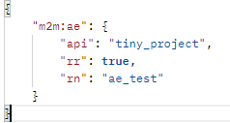
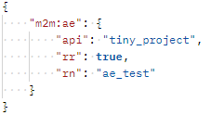
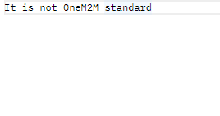
Postman
header has x-m2m-origin, x-m2m-ri value
request body value
header doest not have x-m2m-origin, x-m2m-ri value

